Slide 1
Best Health Web Application specification
BSE Web Devs

Slide 2
Project Developers
Anav Chand – S11221203 (Leader)
Rohan Nandan – S11234883
Vishant Kumar – S11230430
Zhixian Chen – S11230686
Aryan Singh – S11230987

Slide 3
Project overview
Provide secure one-on-one therapy sessions, informative blogs and mental health self-assessment tools.
Promote mental wellness through digital accessibility.
Reach vulnerable populations (youth, people with personal challenges, elderly) and provide mental health guidance

Slide 4
Content Goals
Public Interest Content
Mental health and wellness information accessible to general public.
E-commerce
Booking therapy sessions with payment gateways.
Portal Features
Provide centralized access to resources and services after login.
Blog Content
Therapist-written articles for mental health education.

Slide 5
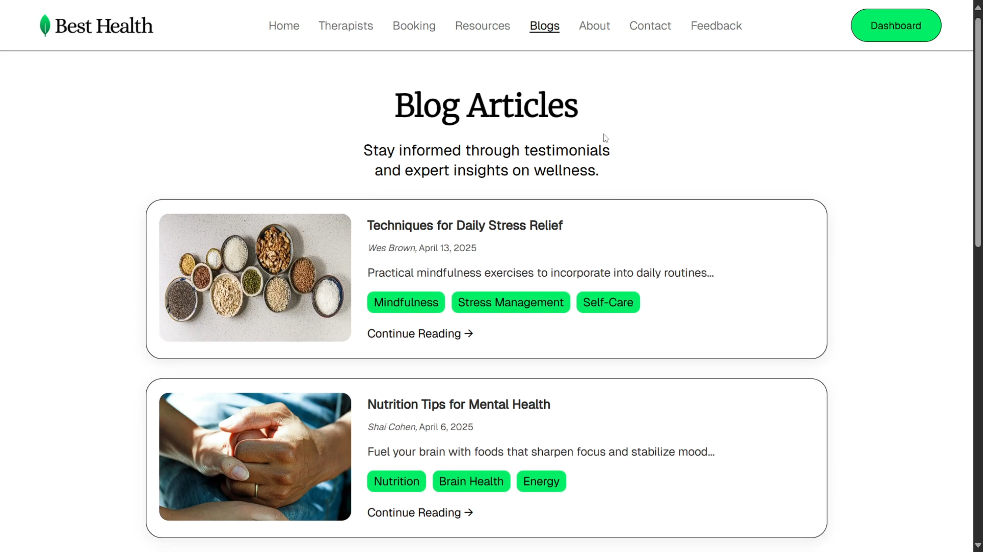
Content goals (cont’d)

Slide 6
Target Audience
Age Groups:
Primary: Young adults (18-35 years)
Students with academic pressures
Young professionals with work-life balance issues
Secondary: Middle-aged adults (36-55 years)
Gender Distribution:
Inclusive approach for all gender identities
Nationality:
Primary: Fiji national population (suburban areas)
Secondary: Rural communities (via articles/videos)
Tertiary: International users seeking remote support

Slide 7
Audience Needs & challenges
Challenges:
Academic and work-related stress
National stigma
Lack of mental health professionals
Solutions:
Secure and private sessions
Easy navigation and accessibility
Affordable or free options
Transparent security measures

Slide 8
Website Pages
Home Page: Brief introduction of the system, latest articles and booking appointments
Therapists Page: List of all therapists
Blogs Page: List of all articles ordered by publish date
Login/Sign Up Page: User authentication
Book Session Page: Appointment scheduling
About/Contact Page: Background information and contact details
Feedback Page: Submit feedback on experience
Resources Page: List of downloadable resources and links
Dashboard Page: View sessions booked in tabular format

Slide 9
Website Pages Reasoning
Home page: Introduces the service and provides initial engagement.
Therapist pages: Allows users to browse and select specialists that suit their needs.
Blog pages: Provide helpful insights and build trust with users through professional advice.
The booking page: Enables users to schedule therapy at their convenience, supporting mental health proactively.
A login/sign-up page: Ensures secure access for users.
Resources page: Provide logged in users with PDFs and links to download and use.
Dashboard page: Track and manage scheduled sessions.
Feedback page: Gain input on quality of service

Slide 10
Core Functionality
User Authentication
Credential-based login
Implementation: Secure authentication system with password hashing
Booking System
Booking therapy sessions
Dropdown list for therapist and time slot selection
Implementation: Database-driven booking system with editing functionality
File Upload
PDF file uploading
Implementation: Upload medical report during session booking, view it via dashboard.

Slide 11
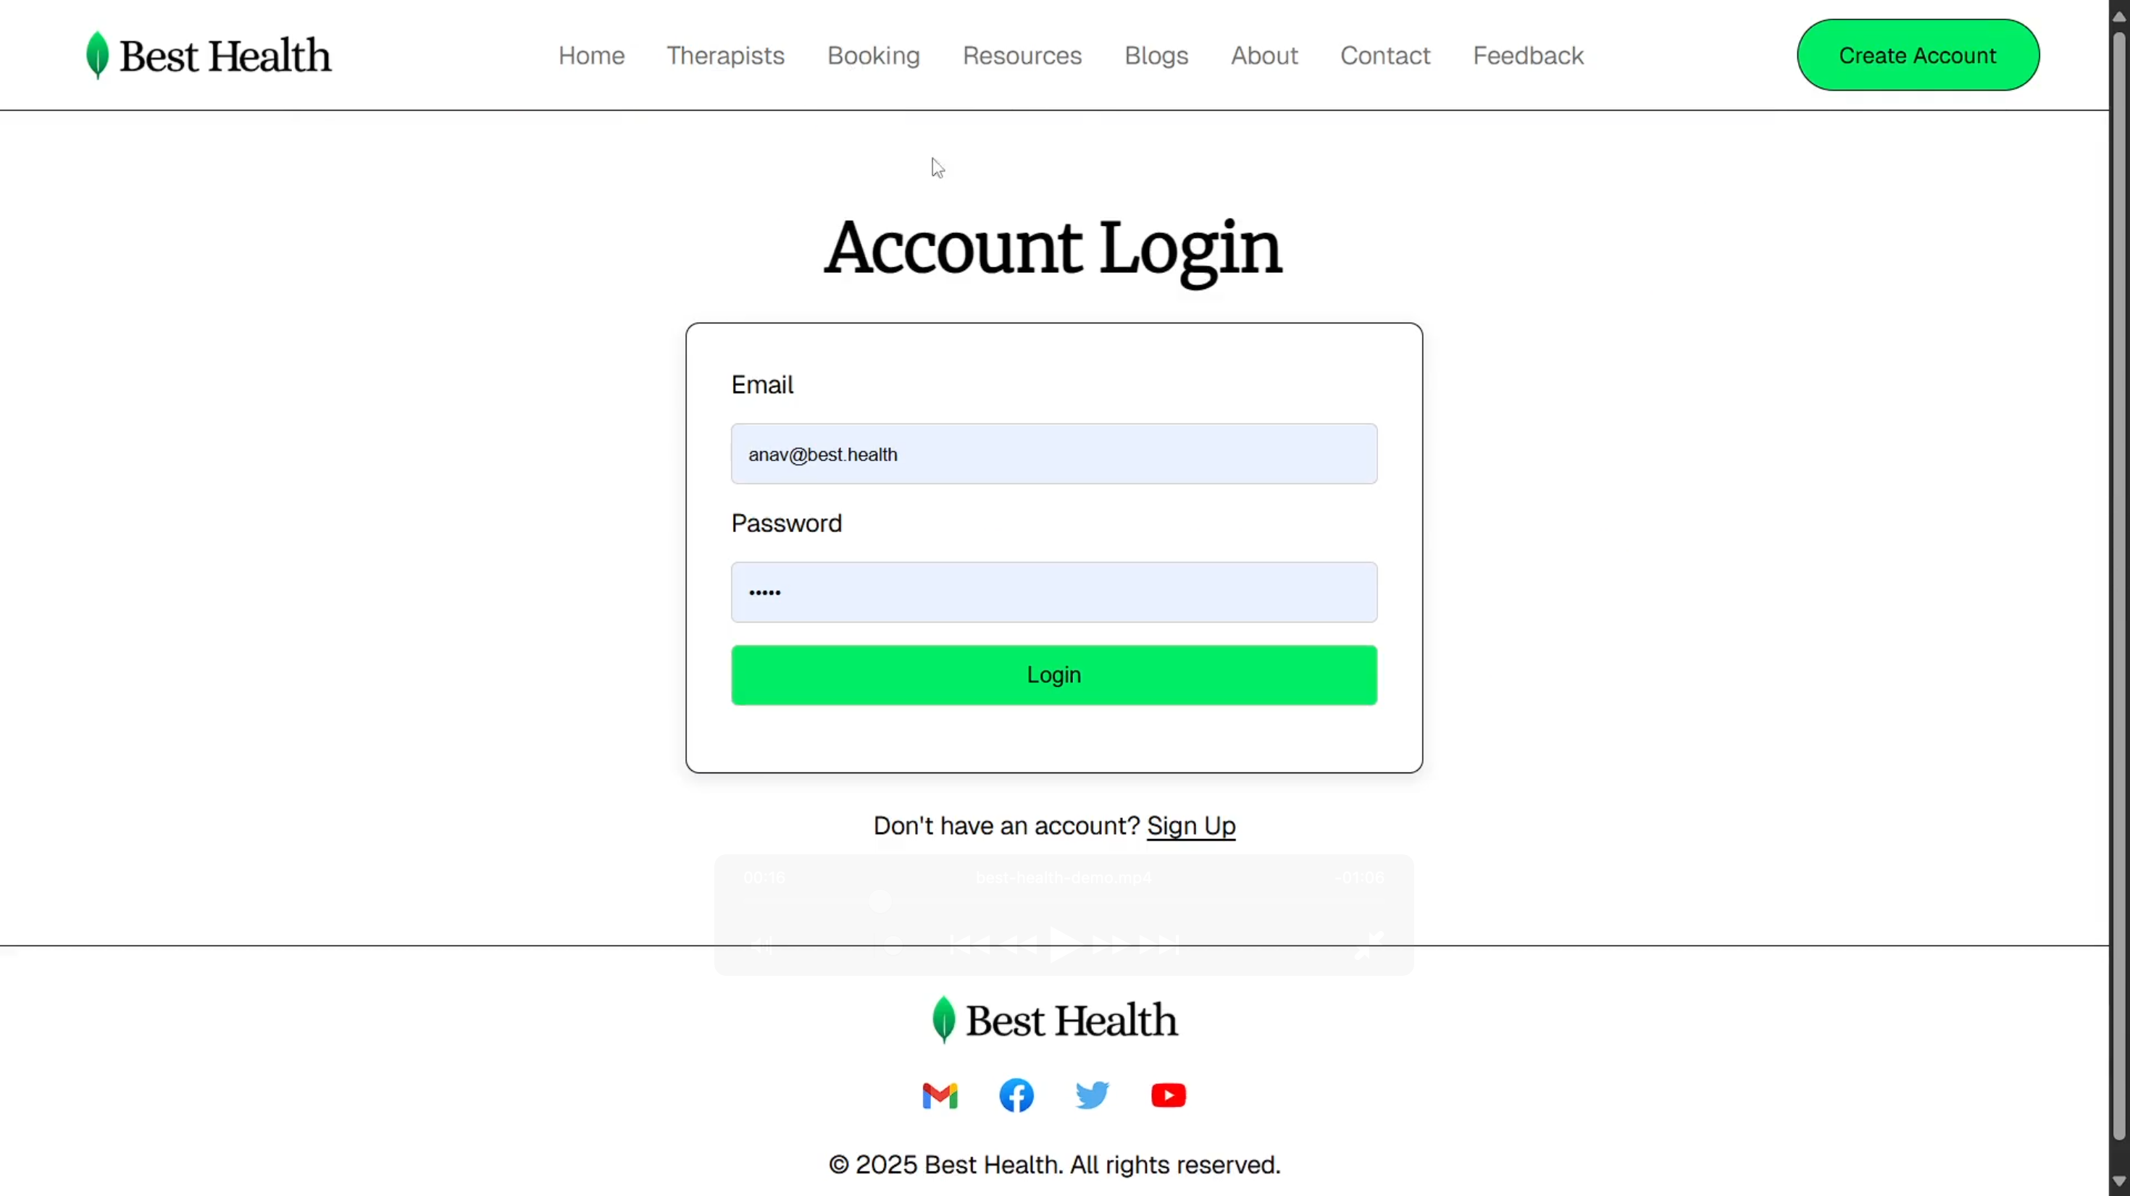
Core Functionality (Login)

Slide 12
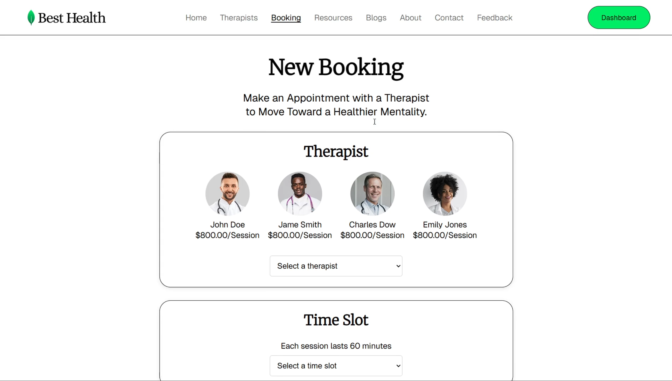
Core Functionality (Booking)

Slide 13
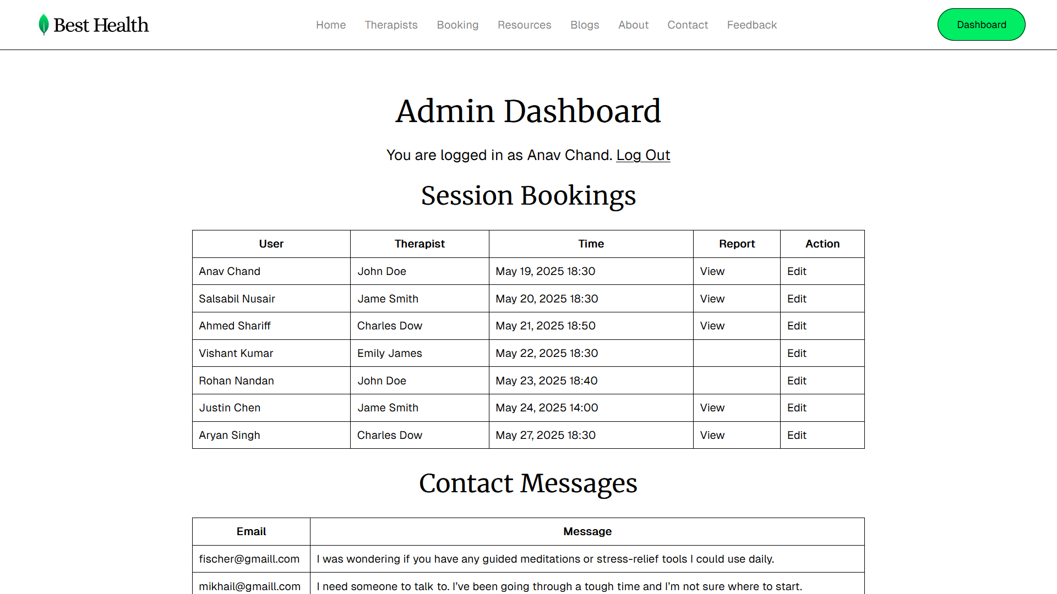
Core Functionality (dashboard)

Slide 14
Omitted Functionality
Thes features have been excluded from final product to due time constraints and implementation complexity.
Session Gifting
Booking Payment
Self Assessment Quiz
Specific Blog Page
Specific Therapist Page
RSS Feed

Slide 15
Website Accessibility
Aria labels
Add helpful labels for screen readers
Use of alt and title tags
Describe images and links clearly
Colour contrast and font size
Guide users on hierarchy of information and improve readability
Easy booking flow
Ability to book sessions within 3 clicks: 2 dropdowns and 1 file upload
Caption element on tables
Create title to or describe tables

Slide 16
Website Performance
Lazy Loading
Images are loaded only when they are needed.
Asset Optimization
Icons are loaded locally (no third-party dependency).
Font Optimisation
Fonts have been converted from .TTF to .WOFF.
Fonts are loaded locally (no third-party dependency).
Font Prefetching
Fonts are loaded before hand to reduce load times and CLS.

Slide 17
Security Measures
Password Salting & Hashing
Appending string (36-character v4 UUID) to end of password.
SHA-256 algorithm implementation: server-side hashing of user password.
Offers data security against data breaches.
Edit Booking Authorization
Only the owner (or admin) of a booking can update/delete it.
Attempt to edit booking not belonging to that user will trigger a redirect.
Parameterized Queries
AccessDataSource uses parameterized queries, which separate SQL logic from user input.
Offers protection against SQL injection.

Slide 18
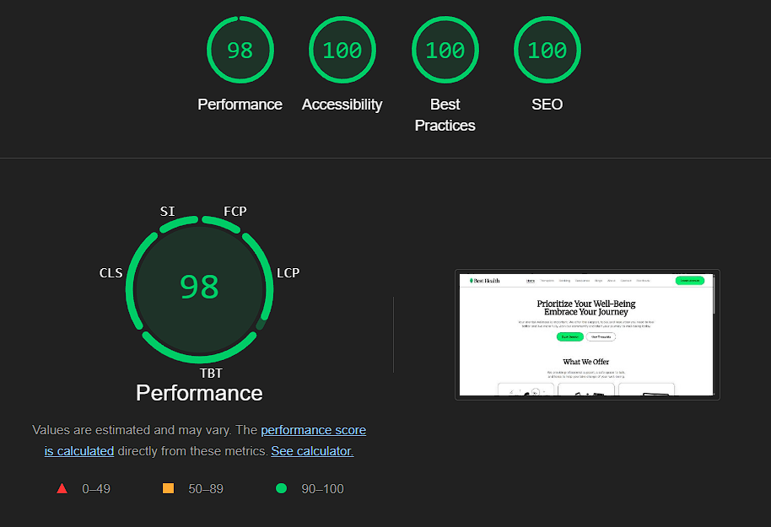
Lighthouse Score: 398/400

Slide 19
Site structure

Slide 20
Site Database ERD

Slide 21
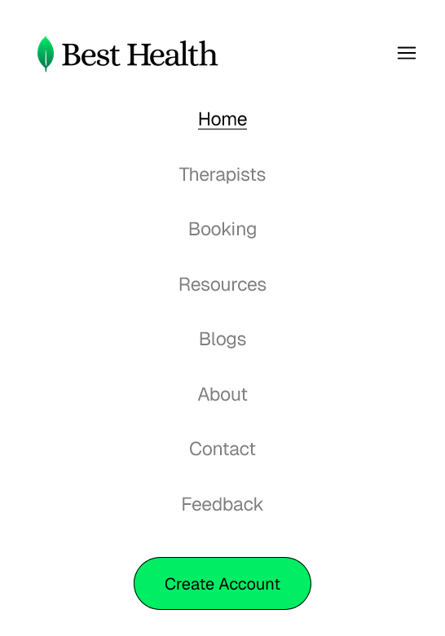
Site navigation
Where am I?
Black font colour and underline for active links.
Where can I go?
Clear visibility of available links in navigation menu.
How do I get there?
Fixed position navigation bar on all pages
How do I get back to where I started?
Persistent home link in navigation

Slide 22
Website layout
Colour Scheme:
White (#FFFFFF). Symbolizes peace and purity.
Black (#000000)
Light Zinc (#CCCCCC)
Spring Green (#00ED64), Symbolizes hope and growth.
Typography:
Main content: Geist Sans (Vercel) , Roboto, Sans-Serif
Headings: Merriweather (Sorkin, E), Georgia, Serif

Slide 23
Website layout (Cont’d)
Changes:
The therapist and resource page design were changed from the initial wireframe
Reasoning:
To better organize the content displayed and enhance accessibility for users.

Slide 24
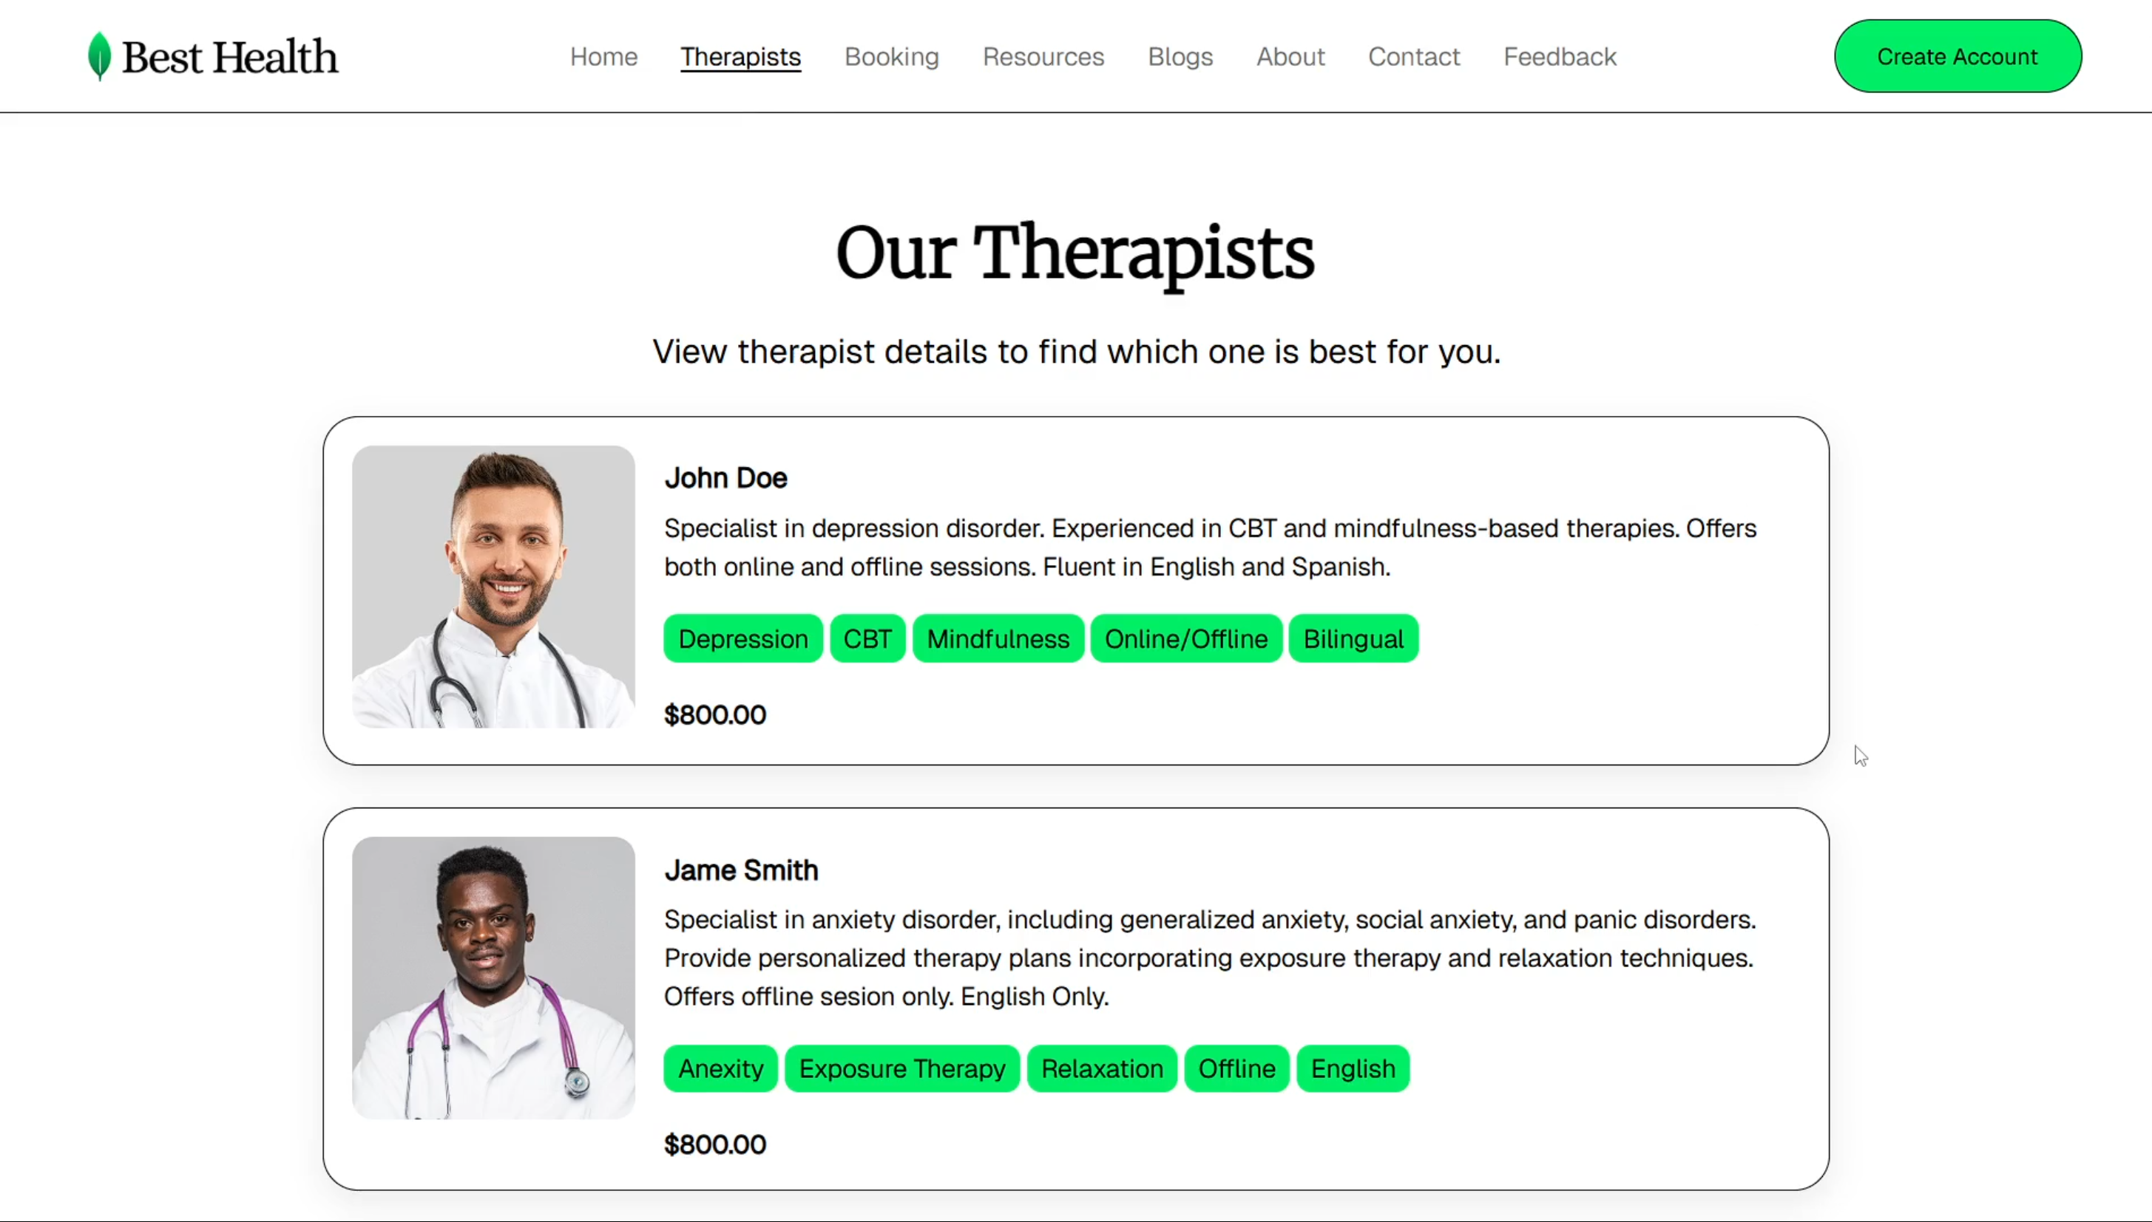
Website layout (cont’d)

Slide 25
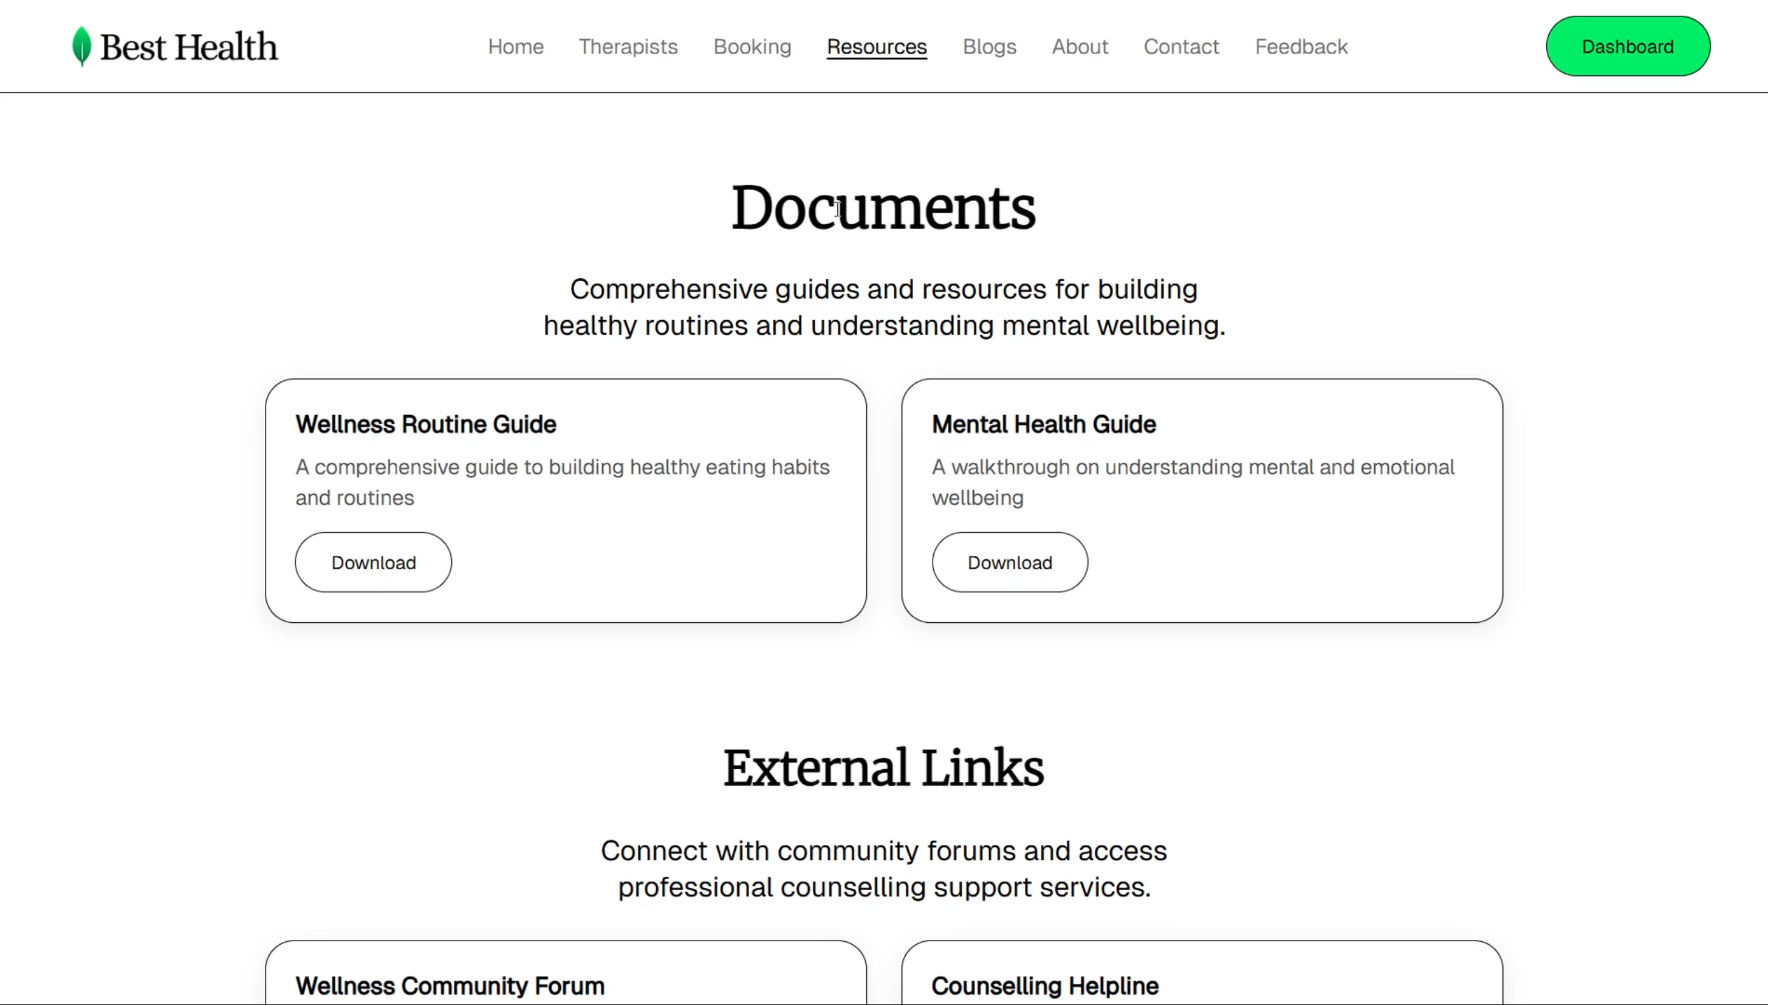
Website layout (cont’d)

Slide 26
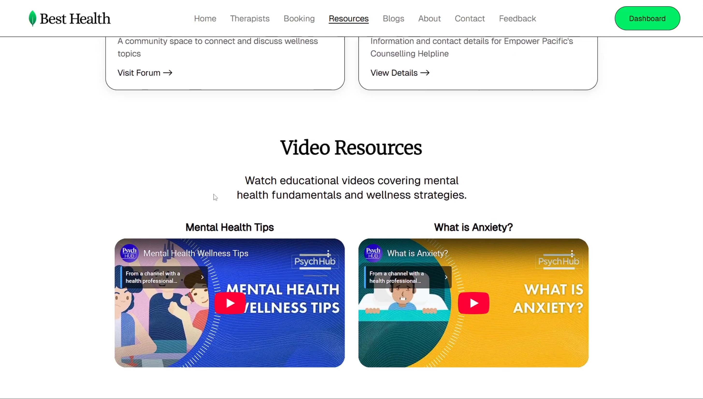
Website layout (cont’d)

Slide 27




Cross-browser support
Browsers Tested:
Google Chrome
Microsoft Edge
Mozilla Firefox
Zen Browser

Slide 28



Software Used
Git
Version control system used track changes made to cover over time.
GitHub
Source code hosting and collaboration. Visit repository.
Trello
Task tracking and project management software using Kanban board.

Slide 29


Software Used (Cont’d)
Audacity
Professional audio recording and editing
Google Lighthouse
Evaluate web performance, accessibility and SEO
Davinci Resolve
Advanced video editing and post-production effects.

Slide 30
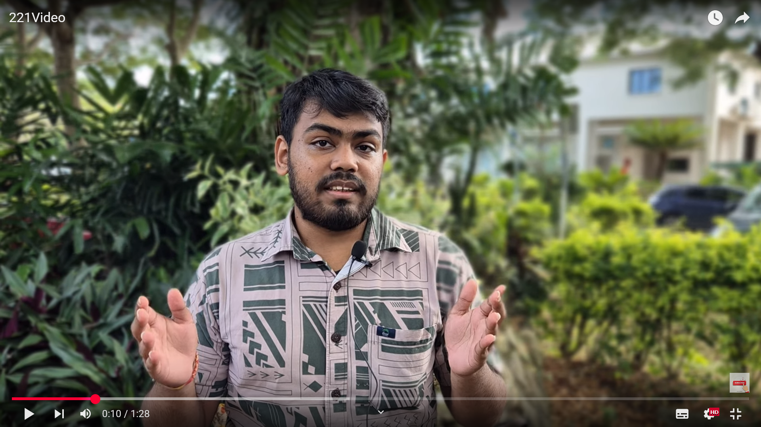
Promotional video
links.anav.dev/best-health-promo

Slide 31
Database user credentials
Email | Password | Role
salsabil@best.health | password | Admin
ahmed@best.health | password | Admin
anav@best.health | password | Admin
vishant@gmail.com | password | Member
rohan@gmail.com | password | Member
justin@gmail.com | password | Member
aryan@gmail.com | password | Member

Slide 32
References
Elsen, H. (2024). Help Elsen Academy by donating popular English and Afrikaans [Image]. Google Images. https://images.app.goo.gl/PLh3EfFHQ8giZSTn8
English, I. (2024). 10 best short stories online to read in English [Image]. Google Images. https://images.app.goo.gl/21JC1dzZVu8qAeCs7
Floor, P. (2024). A pelvic floor physical therapist talks cervical cancer and recovery [Image]. Google Images. https://images.app.goo.gl/v1pcppLFP4oqNwQs9
Freepik. (n.d.). African American black doctor man with stethoscope isolated white background [Photograph]. https://www.freepik.com/free-photo/african-american-black-doctor-man-with-stethoscope-isolated-white-background_8933852.htm

Slide 33
References (CONT’D)
Freepik. (n.d.). Doctor [Photograph collection]. https://www.freepik.com/photos/doctor
Freepik. (n.d.). Family doctor doctor's office [Photograph]. https://www.freepik.com/free-photo/family-doctor-doctor-s-office_4506048.htm
Freepik. (n.d.). Front view female doctor wearing white coat [Photograph]. https://www.freepik.com/free-photo/front-view-female-doctor-wearing-white-coat_33417237.htm
Freepik. (n.d.). Smiling doctor with stethoscope isolated grey [Photograph]. https://www.freepik.com/free-photo/smiling-doctor-with-strethoscope-isolated-grey_26673614.htm

Slide 34
References (cont’d)
Heroicons. (n.d.). Heroicons. https://heroicons.com
Microsoft. (n.d.). AccessDataSource class (System.Web.UI.WebControls). Microsoft Learn. https://learn.microsoft.com/en-us/dotnet/api/system.web.ui.webcontrols.accessdatasource?view=netframework-4.8.1
Seeds, C. (2024). Variety raw uncooked grains superfood cereal chia seeds sesame [Image]. Google Images. https://images.app.goo.gl/yX5Rx4HmbDCtj2Kk8
Sorkin, E. (n.d.). Merriweather [Font]. Google Fonts. https://fonts.google.com/specimen/Merriweather
Streamline HQ. (n.d.). Streamline HQ profile [User profile]. Figma. https://www.figma.com/@streamline_hq

Slide 35
References (cont’d)
SVGL. (n.d.). SVGL: A beautiful library of SVG logos. https://svgl.app
Take. (2024). Take down the stigma: Erlanger to open Chattanooga facility [Image]. Google Images. https://images.app.goo.gl/88Cy4iC61gWXgy6Q7
Vercel. (n.d.). Geist font. https://vercel.com/font

